Slide 1


Dimas Jackson
May 1, 2023

Slide 2

Outline
Executive Summary
Introduction
Methodology
Results
Conclusion
Appendix

Slide 3
Executive Summary
Summary of methodologies
Data collection from Space X database and web
Descriptive data analysis
Predictive analysis with Machine Learning
Summary of all results
The launch site KS LC-39A, payload mass between 2500-5000 kg and orbit type SSO have highest success rate.
We can predict if a launch will be successful or fail with 87% accuracy in test data

Slide 4
Introduction
In this project, I predicted if the Space X Falcon 9 first stage will land successfully
I collected, processed and analyzed data and built, validated and compared Machine Learning models to understand the most relevant variables related to the improving of success rate.

Slide 5

Section 1

Slide 6
Methodology
Executive Summary
Data collection methodology:
Data extraction from Space X API and webscraping from Wikipedia
Perform data wrangling
Missing values treatment and class labeling
Perform exploratory data analysis (EDA) using visualization and SQL
Perform interactive visual analytics using Folium & Plotly Dash
Perform predictive analysis using classification models
Hyperparameter tuning for SVM, Classification Trees and Logistic Regression

Slide 7
Data Collection
Space X API data request and webscraping from Wikipedia:
Space X API
Falcon 9 HTML table from Wikipedia
Rockets
Launchpads
Cores
Payloads
Request JSON files
Parse table using Beautifulsoup
Pandas Data Frame
Pandas Data Frame
Cleaning and filtering
Apply filters
CSV file
CSV file

Slide 8
Data Collection – SpaceX API
Extract and concatenate past launch data using ‘requests’ library
Replace missing payload mass by the column average
Filter by the relevant features to analysis
Data Collection Github link
Space X API
Rockets
Launchpads
Cores
Payloads
Request JSON files
Pandas Data Frame
Cleaning and filtering
CSV file

Slide 9
Data Collection - Scraping
Falcon 9 HTML table from Wikipedia
Store the html table response in a txt file
Parse headers, rows and coluns
Create a Pandas data frame
Export a CSV file
Webscraping Git Hub link
Parse table using Beautifulsoup
Pandas Data Frame
Apply filters
CSV file

Slide 10
Data Wrangling
Import the CSV files created in data collection
Calculate the number of launches for each site
Find the number of occurrences for each orbit
Create a landing outcome label from Outcome column
Data Wrangling Git Hub link

Slide 11
EDA with Data Visualization
Scatter plot FlightNumber vs. PayloadMass and Launch Site, to understand how these variables affect the launch outcome
Use barplots to understand the relationship between success rate of each orbit type
Visualize the launch success yearly trend using line chart
Data Vizualization Git Hub link

Slide 12
EDA with SQL
Display average payload mass carried by booster version F9 v1.1
List the names of the boosters which have success in drone ship and have payload mass greater than 4000 but less than 6000
List the names of the booster_versions which have carried the maximum payload mass.
List the failed landing_outcomes in drone ship, their booster versions, and launch site names for in year 2015
EDA with SQL Git Hub Link

Slide 13
Build an Interactive Map with Folium
Mark the success/failed launches for each site on the map
Mark down a point on the closest coastline and calculate the distance between the coastline point and the launch site.
Draw a line between a launch site to its closest city, railway and highway
Folium Map Analysis Git Hub Link

Slide 14
Build a Dashboard with Plotly Dash
Pie chart to show the total successful launches count for all sites
Scatter chart to show the correlation between payload and launch success.
Pie chart to show the Success vs. Failed counts for the site
Dashboard Git Hub Link

Slide 15
Predictive Analysis (Classification)
Standardize the data
Split into training data and test data
Find best Hyperparameter for SVM, Classification Trees and Logistic Regression using cross validation
Find the method performs best using test data
Machine Learning Analysis Git Hub Link

Slide 16
Results
Success rate improve with flight number for all sites.
The orbits ES-L1, GEO, HEO and SSO have high success rate.
The success rate since 2013 kept increasing till 2020
Payload mass range 2500-5000 kg has the highest launch success rate
We can predict the landing success with 87% accuracy using Decision Tree model

Slide 17

Section 2

Slide 18
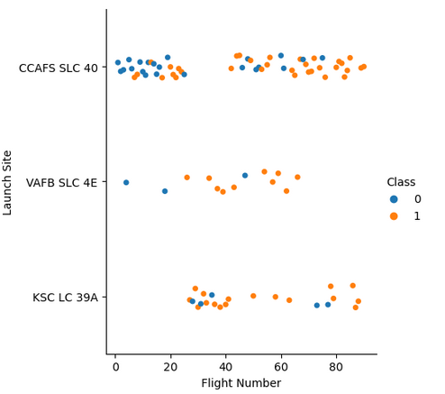
Flight Number vs. Launch Site
Success rate improve with flight number for all sites
CCAFS SLC 40 had much more launches

Slide 19
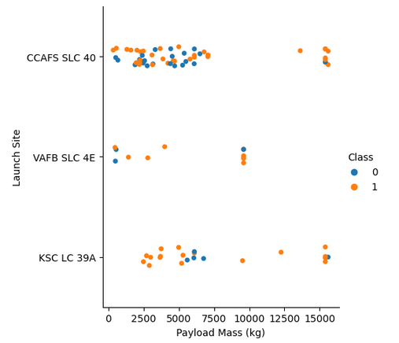
Payload vs. Launch Site
There are more launches for lighter stages
For the VAFB-SLC launchsite there are no rockets launched for heavy payload mass(greater than 10000).

Slide 20
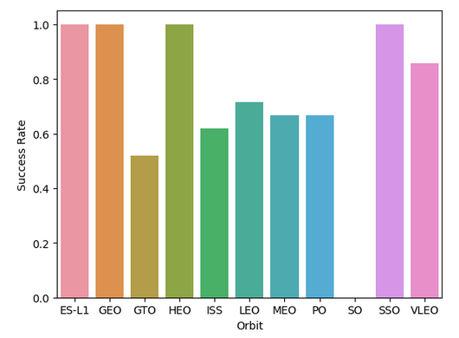
Success Rate vs. Orbit Type
The orbits ES-L1, GEO, HEO and SSO have high success rate
SO orbit success rate is zero

Slide 21
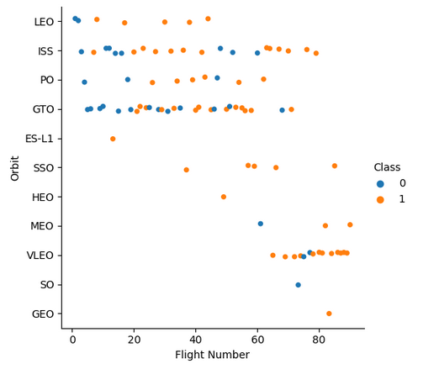
Flight Number vs. Orbit Type
Although the success rate being 1, GEO, ES-L1 and HEO have just one launch
The success rate seems Show the screenshot of the scatter plot with explanationsto increase with flight number for LEO but there are no relationship for GTO
SSO looks the best choice

Slide 22
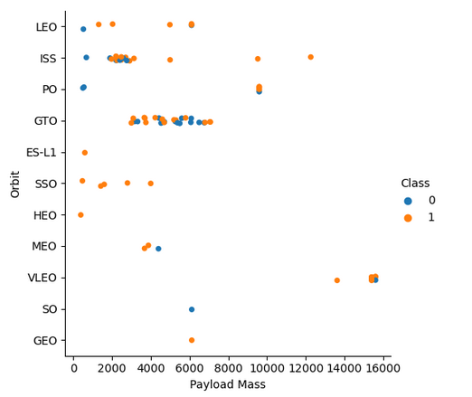
Payload vs. Orbit Type
With heavy payloads the successful landing or positive landing rate are more for Polar,LEO and ISS.
For GTO we cannot distinguish this well as both positive landing rate and negative landing are both there here.

Slide 23
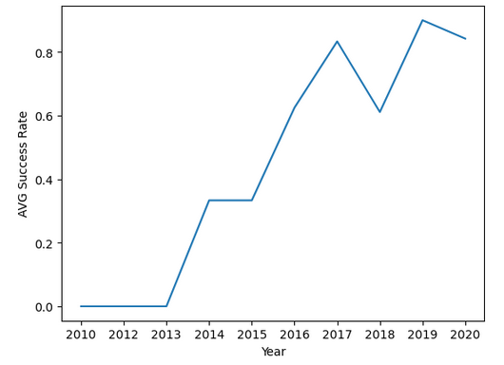
Launch Success Yearly Trend
The success rate since 2013 kept increasing till 2020

Slide 24
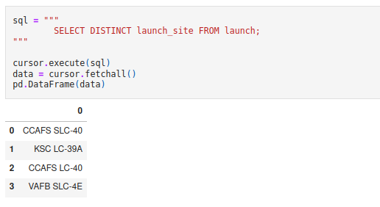
All Launch Site Names
The SQL query to find the distinct launch sites:

Slide 25
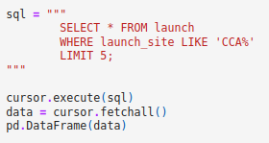
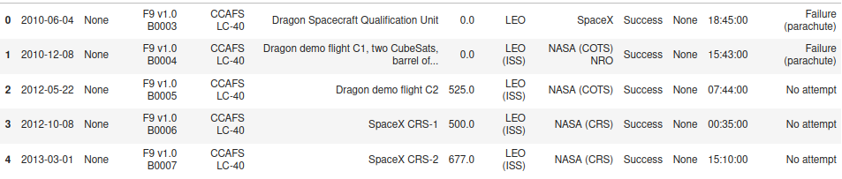
Launch Site Names Begin with 'CCA'
SQL query to find 5 records where launch sites begin with `CCA`:

Slide 26
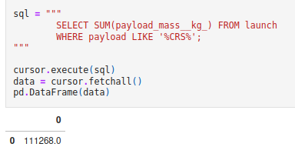
Total Payload Mass
SQL query to calculate the total payload carried by boosters from NASA

Slide 27
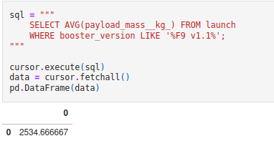
Average Payload Mass by F9 v1.1
SQL query to calculate the average payload mass carried by booster version F9 v1.1

Slide 28
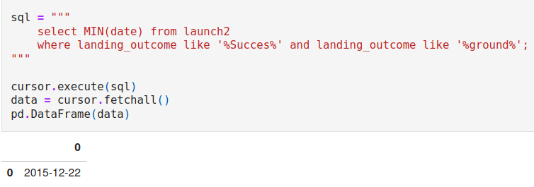
First Successful Ground Landing Date
SQL query to find the dates of the first successful landing outcome on ground pad

Slide 29
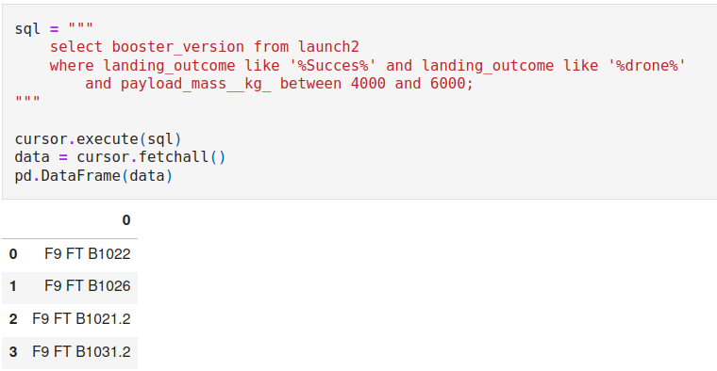
Successful Drone Ship Landing with Payload between 4000 and 6000
Names of boosters which have successfully landed on drone ship and had payload mass greater than 4000 but less than 6000

Slide 30
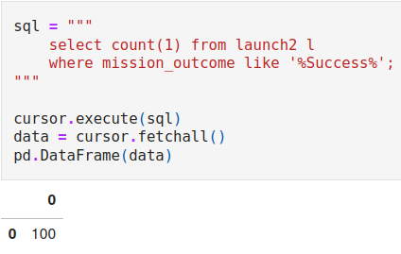
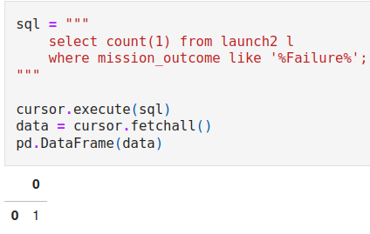
Total Number of Successful and Failure Mission Outcomes
SQL query to calculate the total number of successful and failure mission outcomes

Slide 31
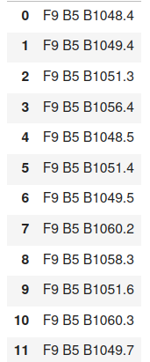
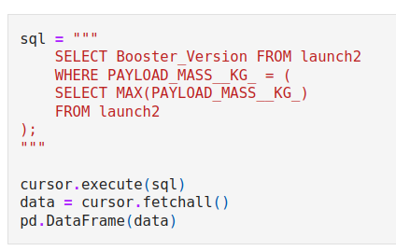
Boosters Carried Maximum Payload
List the names of the booster which have carried the maximum payload mass

Slide 32
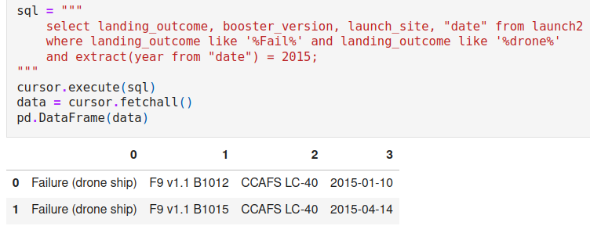
2015 Launch Records
List of the failed landing_outcomes in drone ship, their booster versions, and launch site names for in year 2015

Slide 33
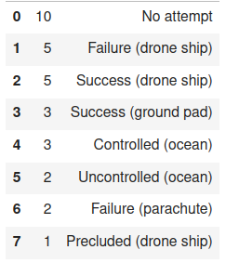
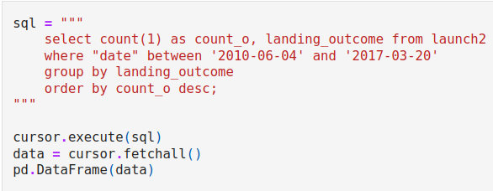
Rank Landing Outcomes Between 2010-06-04 and 2017-03-20
Rank the count of landing outcomes (such as Failure (drone ship) or Success (ground pad)) between the date 2010-06-04 and 2017-03-20, in descending order

Slide 34

Section 3

Slide 35
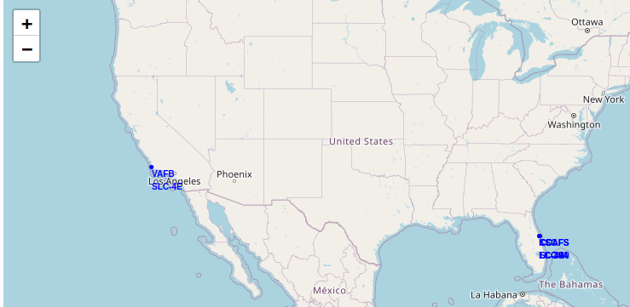
<Folium Map Screenshot 1>
Generated folium map with all launch sites’ location markers on a global map

Slide 36
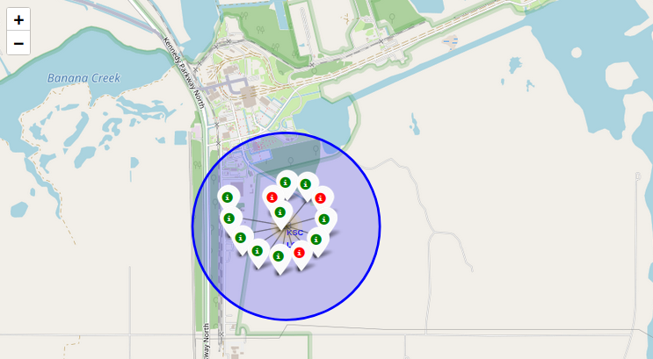
<Folium Map Screenshot 2>
Color-labeled launch outcomes in KSC LS: success (green) failure (red)

Slide 37
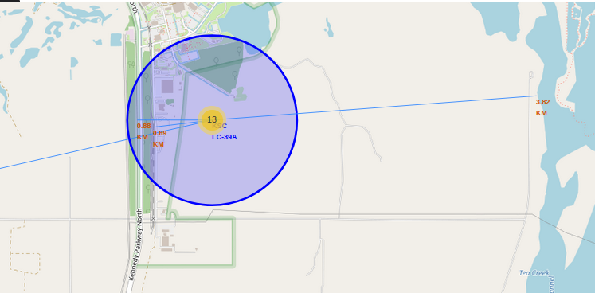
<Folium Map Screenshot 3>
Launch site to its proximity railway, highway, coastline, with distance

Slide 38

Section 4

Slide 39
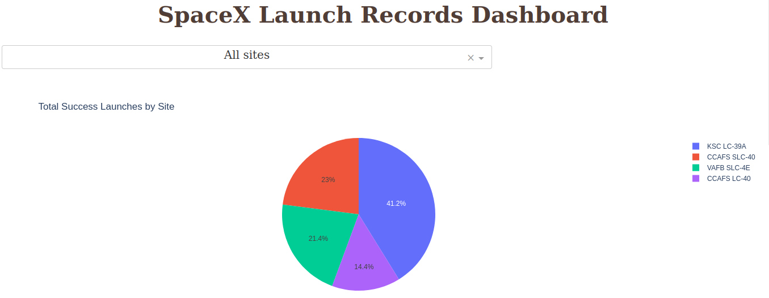
Interactive Plot Success Launches by Site
The KSC LC-39A site had the highest number of success launches

Slide 40
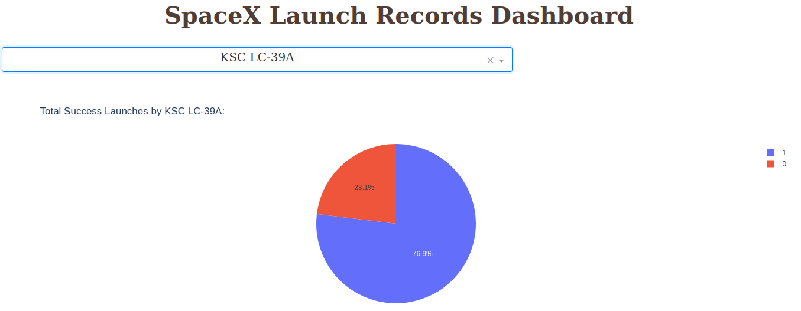
Interactive Plot Launch Site with highest success
76.9% of launches had success in site KSC LC-39A

Slide 41
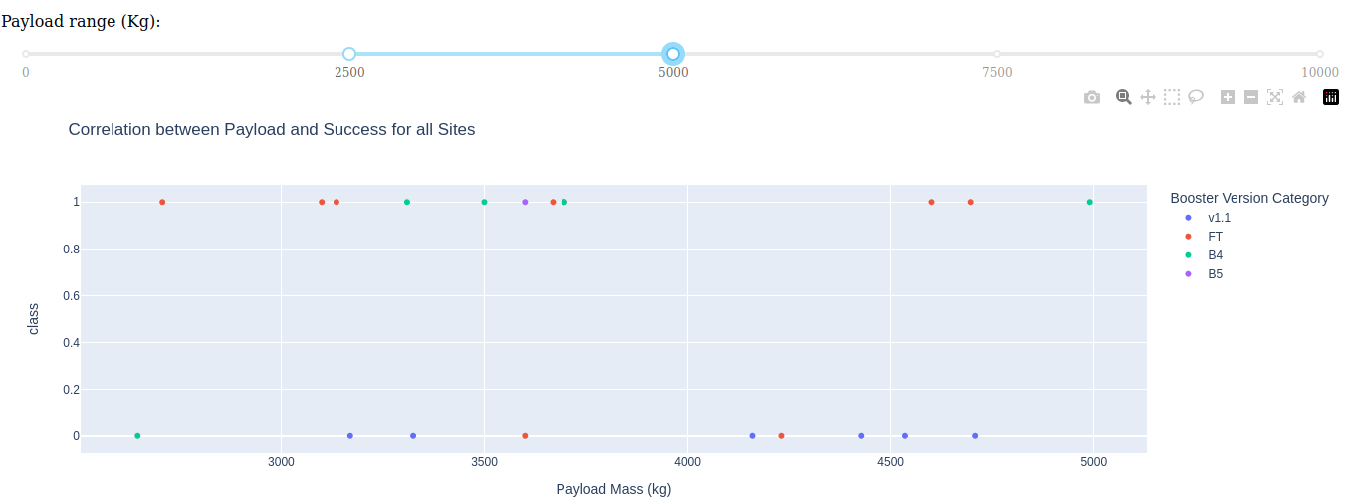
Interactive Plot Payload Mass vs. Success Class
The best payload mass range was 2500-5000 kg

Slide 42

Section 5

Slide 43
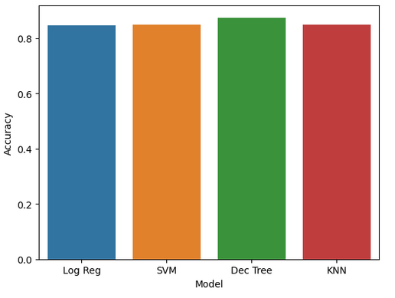
Classification Accuracy
All models considered have accuracy greater than 80%
The best classifier was Decision Tree, with 87.5% accuracy

Slide 44
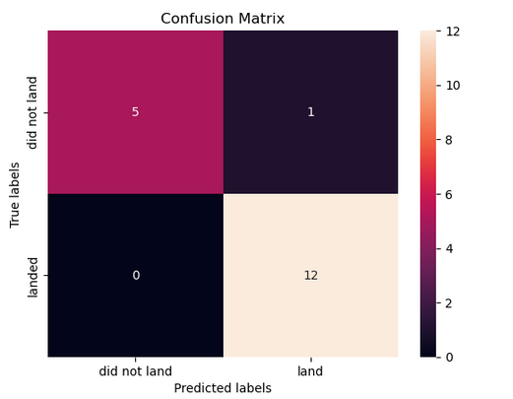
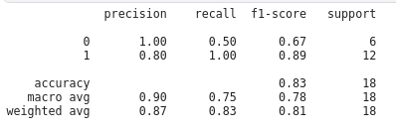
Confusion Matrix
The Decision Tree model performed well in predicting the successful landing

Slide 45
Conclusions
The better choice to improve the success rate is: Launch site KS LC-39A, payload mass between 2500-5000 kg, orbit type SSO.
Given the payload mass, launch site, and orbit type we can predict if a launch will be successful or fail with 87% accuracy in validation data
Space X may save USD 100 million by reusing the first stage of Falcon 9, so this findings could improve the company profit

Slide 46
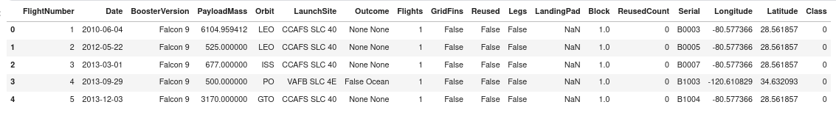
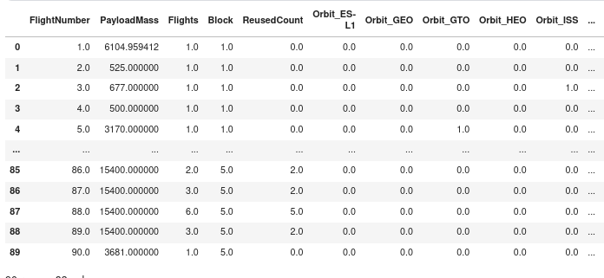
Appendix
Data set created during this project before and after one hot encoding

Slide 47


